Slide 1
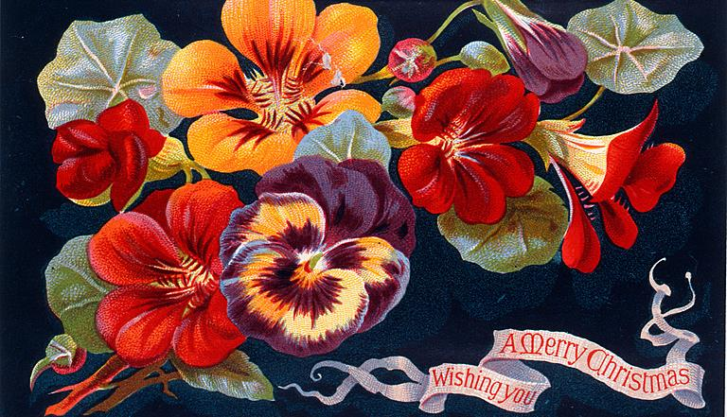
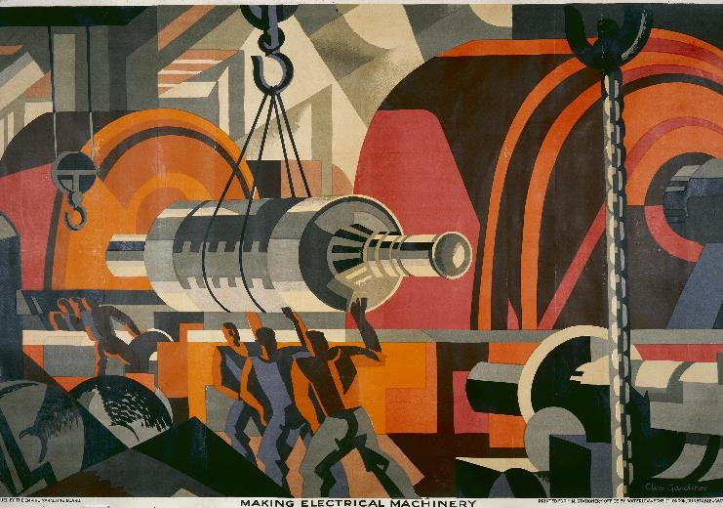
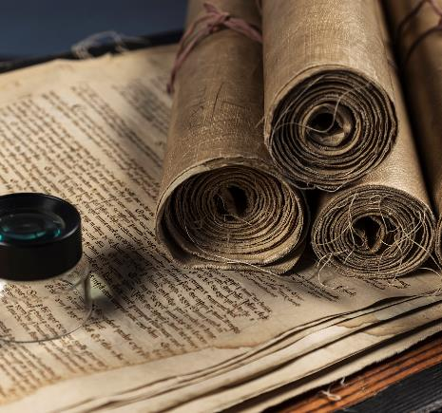
Wrapping Up
What have we done, who might it be for and what have we learned?
Notes:
My original intent was to do more work on the data during this visit and report back on that
And then that evolved into working more on how people actually might make use of text mining tools and what audiences they might be for
What I’ve mostly actually done is preparing the next group activity, or reflecting on the last one (or often both at once)
Taking a step back from the coalface and actually taking a breath and thinking a bit has been helpful, though
I don’t want to take everyone back through everything again like I did at the start of this visit, last week
But I’m quite confident that we’ll finish early, so if anybody new would like to see a bit more of what this project has actually been, I’m happy to take you through it at the end
So I think this is more of a brief “what has this project produced”
A few reflections on audiences, which was something I wanted to think about this week
And an activity around what we’ve learned
So 3 fairly different things

Slide 2
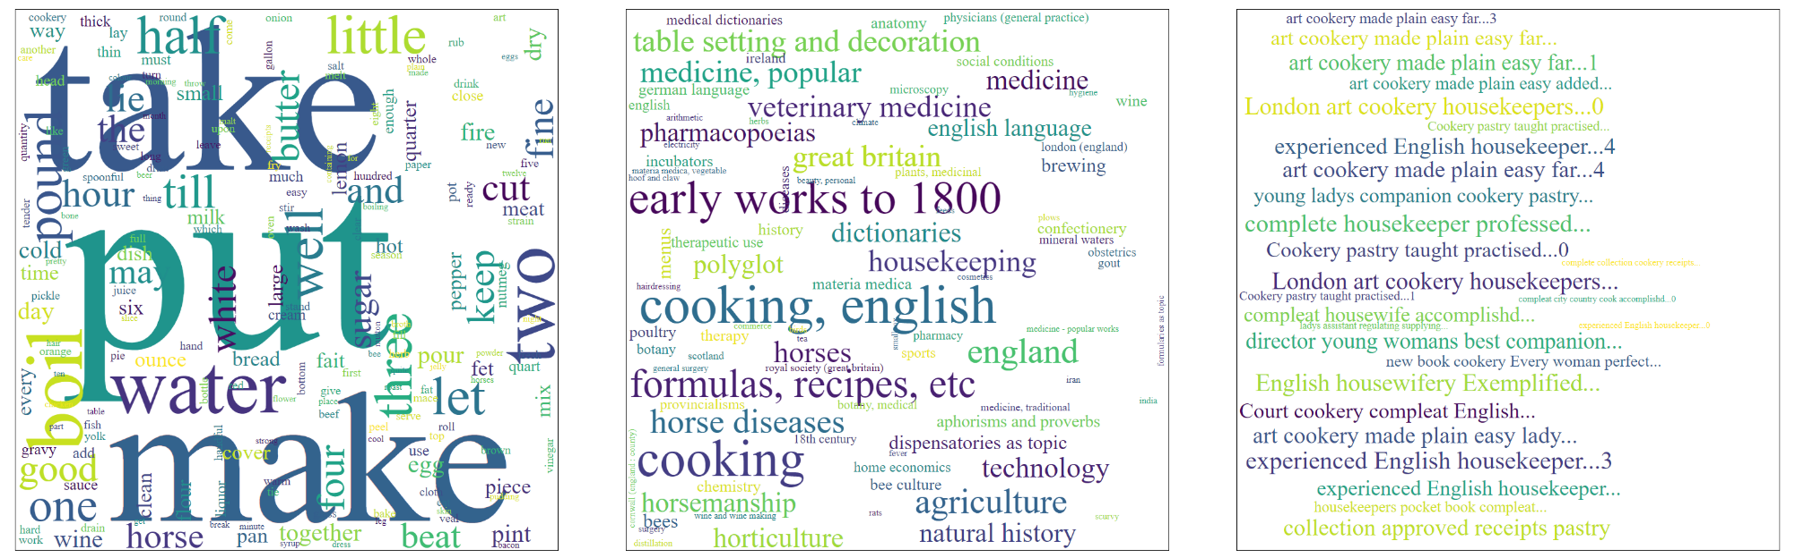
The very quick intro (1/2)
Notes:
Just to give some context for people who have not been before
The main thing to be aware of is topic models and how we can try to make use of them
A topic model is created by a statistical process applied to a corpus of text
You can think of a topic model as a word cloud of terms that are relevant to some topic
But you have to figure out for yourself what the topic is
Here the word cloud on the text is a topic model
This one seems to be about recipes
The word cloud on the right is showing the books in which this topic is important
The one in the middle is the catalogue subjects of the books in which the topic is important
So if you have a page full of these you can use them to browse the collection and start to get a sense of what is in it
And sometimes you will see things that look like a couple of topics combined together, which might suggest connections

Slide 3
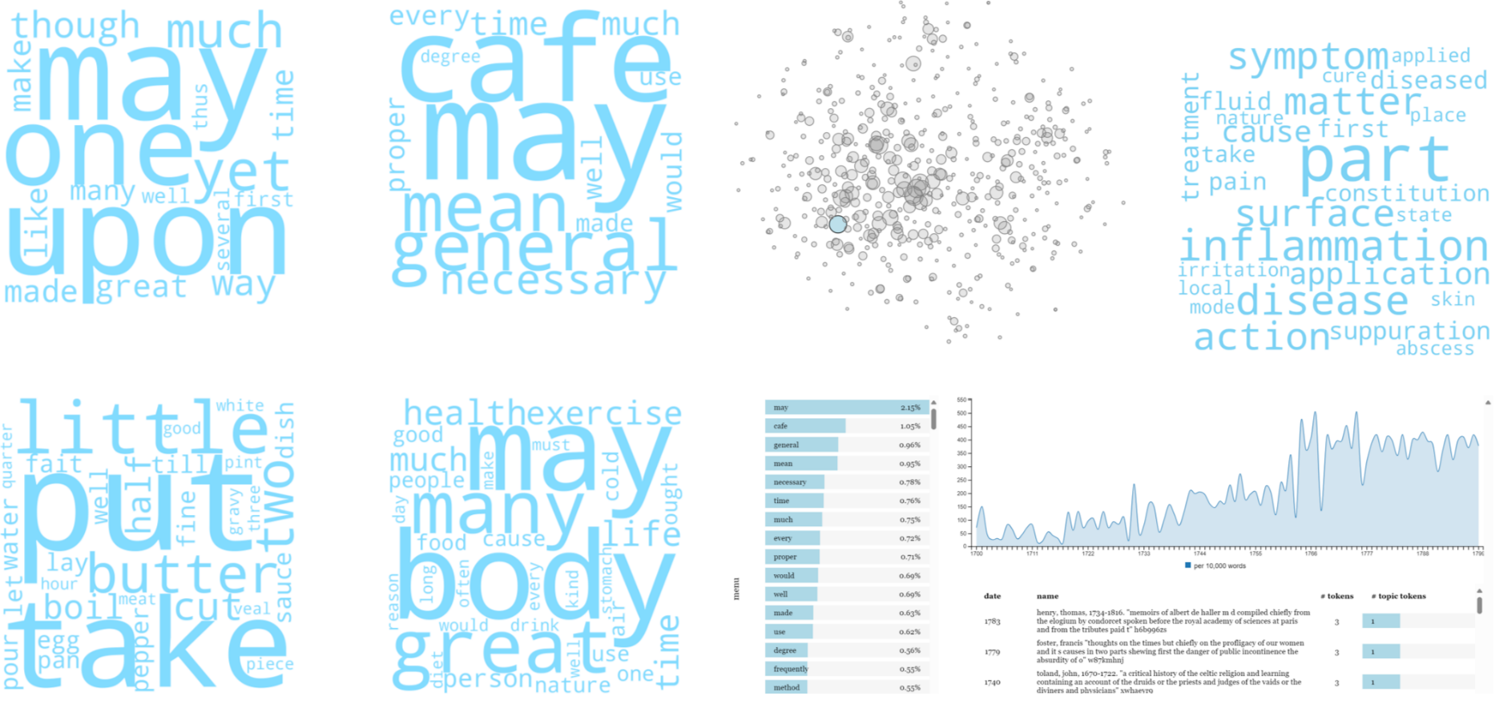
The very quick intro (2/2)
Notes:
We can visualise these in a range of ways
So here you see a few more topic clouds
But also a view that clusters topics together by similarity
And another that shows how a topics prevalence changes over time
Though I’m a bit more distrustful of this kind of analysis, it is certainly something that people do
If you like, I can show you lots more at the end
I hope this is enough for the rest of this to make sense

Slide 4
What’s come of this?
A rough text processing pipeline
An awful lot of transformed text
Several topic model views of the collection
A few interfaces for working with those models
A JOHD paper (in review, nearly)
A poster at TNA (part of the Annual Digital Lecture)
Notes:
So as this is also a wrapup, I thought I’d start with some more concrete things that have come out of the project
Rough text processing pipeline – it’s not production quality, but I have a sort of framework for:
Grabbing your text
Chopping it up and transforming it in a few different ways
Building topic models
And visualising all of that
It’s in GitHub, so it is available for anyone who might want it
If I can find a bit of time over the next few months then I’ll tidy it up a little bit
Definitely want to document it a bit more
A lot of preprocessed text
The directory that it lives in contains something like a terabyte of data
The pipeline’s data storage is not efficient so there’s a lot of redundancy there, but it’s still a lot of words
I don’t really have anywhere to put it so not sure what’ll happen to it
It’s nowhere near as well provenanced as I would like
With a production-quality pipeline I’d be able to tell you exactly how everything was made, this is more rough and ready than that
Several topic model views of the collection and interfaces for working with them
Which we’ve talked about plenty, so I won’t get into that again

Slide 5
Still to come
Project report
TNA blog(s)
Tutorial on topic modelling with Wellcome’s text
A conference presentation
Notes:
And then I promised some stuff when I applied to do this thing
So a project report and at least one blog for TNA
Focusing more on the collaboration aspect of the project
A tutorial for Wellcome on doing topic modelling with your text
(If I can find the time, I might also spend a little while exploring the collection via topics and blog about that, somewhere.
Having built a thing, it would be nice to spend a bit more time using it.)
Hopefully a conference presentation

Slide 6
What else *could* we make? Who would it be for?
Notes:
To start with what we *could* make – lots of things
I’ve not spent as much time with the topics as I’d have liked
But I already know a a couple of tools I need to help me make sense of it
A way of seeing how many different titles are important in the topic
So that I can distinguish between topics that really represent a single book and topics that represent a range of texts
A way of searching through the topics for particular terms, or for any of a range of terms
A way of clustering related topics together (which is something HaToRI offered)
And I’m sure lots more if I were to engage with it more
It’s a bit solipsistic though, being my own target user
I set out to explore search, what I have at the moment is more of a distant view
Which is a Digital Humanities term for these kinds of overviews of large quantities of material
As opposed to more traditional methods based on close reading
While one way to develop this further is to work more on search
Another would be to work on “storytelling”
For example, looking at trends in topics over time
And building representations of that – which can be as simple as line graphs
And perhaps explanatory text interpreting it
In thinking about what we could build, we need to think who it would be for and what it would be intended to do
Based on earlier exercises this week, I wonder for example whether there are ways to
build tools or interfaces that might be a basis for outreach
build tools that are effective for low-resource ways of accessing the internet
e.g. low-end phones, which also bring up considerations of screen space
e.g. minimal data transfer for metered connections

Slide 7
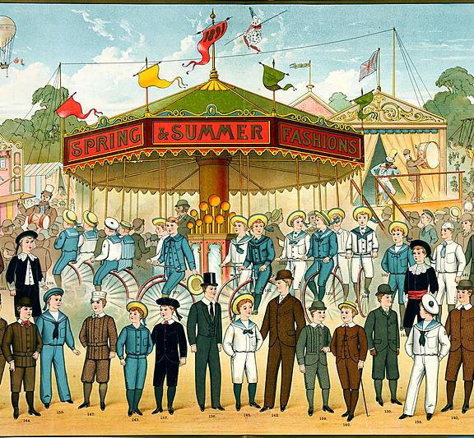
Audience Thoughts
Notes:
Did try to focus this last couple of weeks more on thinking about audiences and uses
So here are a few reflections on possible (mostly digital) audiences
This is a bit of a jumble of thoughts, it won’t be super-coherent
As ever, please feel free to chip in

Slide 8
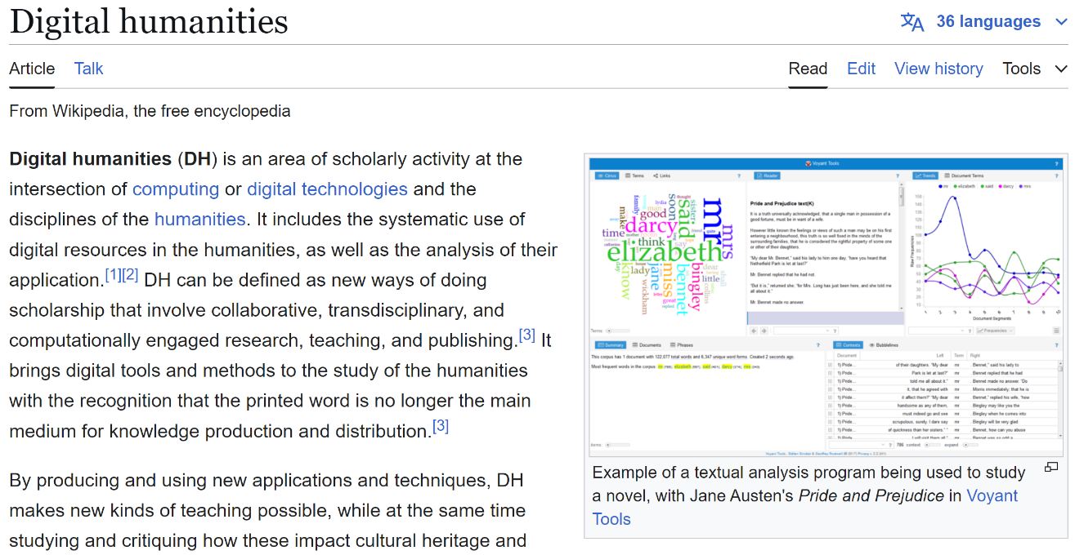
Digital Humanists And other more or less academic researchers
Notes:
Digital humanists and other researchers
Seem like an obvious audience and I guess the one that I tend to think of
Being as it is quite close to what I do and also the kind of audience that my own team at TNA tends to interact with
There is obviously a lot of research potential in all of this text
In, actually, all sorts of ways
From the very technical e.g. can we clean up all this dirty OCR, can we detect meaningful structure like chapters, footnotes, marginalia
Through to much more traditional sorts of history questions that perhaps take a more distant stance e.g. how does the discourse about typhus change over the long eighteenth century
It might be particularly attractive to folks with a linguistic bent e.g. how does the terminology around typhus change over the long eighteenth century
And of course it doesn’t have to be the eighteenth century
Probably some of the technical difficulties are reduced with more modern text
I’m sure digital humanists are already working with it
There may be some wheel reinvention and redundant processing going on – different people transforming the text in the same or similar ways
I wonder if more documentation or examples around how to find things in the catalogue
Or perhaps more standardised forms of data (e.g. date formats) might help

Slide 9

Wellcome Staff
Notes:
In many ways I suppose that “Wellcome Staff as an audience for this kind of thing” is going to be quite similar to Digital Humanists
But perhaps looking more at the GLAM side – more about developing the collection than using it in service of a research project
So includes applications like exploring automatic (or human in the loop) classification of texts with no catalogue subject
Or finding offensive material
Or research around an exhibition
Or to find material relevant to a particular community group
etc etc
One benefit of Wellcome Staff as an audience is what we used to call dogfooding when I worked in tech
By making use of digital tools that you produce, you get more of an end user perspective on that thing yourself
Which gives you insight into how to improve it or make new uses of it
Which in turn might help with advising other audiences such as digital humanists...

Slide 10

Hacker Communities
Notes:
I’m at risk of focusing too much on a potentially narrow audience here
But it is one with a lot of potential
This is the nice kind of hacker
So technically minded people, good with software and data, often very motivated by the good of the community
Some background here – the free software movement
“Free as in freedom, not free as in beer”
It’s not about not paying for the software, it is about being free to duplicate it, change it, build upon it
Although “not paying” can be a consequence of that
This is the GNU logo – GNU being one big part of free software
Huge amounts of the technical infrastructure that we all use all the time is made available under licenses that allow it to be freely reused
And developed and maintained by communities of hackers
Often in the pay of corporations, but not necessarily
For some, it is a passion project
Critically, a mixture of licenses and community norms mean that corporations don’t own the software, and whole community needs tend to get priority
One thing that bugs me about digital infrastructure in GLAMs, and in Digital Humanities more generally, is a feeling that:
Wheels get reinvented
Completed projects sit around for a while, hopefully get used a bit, and then die for lack of funding
If we could build open communities around infrastructure perhaps we could pool effort, save costs, keep things alive
One obvious difficulty here is that, if you start volunteering within a major open source project like GNU
Then you’re building a set of highly valued skills that all but guarantee you a well-paid job forever
This just isn’t the case for cultural heritage data
But anyway the point is that if you make the digital components available, then you might attract creative hackers with some interest in humanities data
While one of the things that unites the free software community is a deep fascination with digital technologies, it isn’t true that everyone in it is monomaniacally interested in this kind of thing
You have already made some digital components available, but perhaps continuing to develop this could attract this kind of audience
You’re quite explicit and open about licensing, which is something else this community often cares about
So if you build it, they _might_ come
On the positive side, this kind of audience doesn’t need things to be quite as easy to work with as the Digital Humanities audience does
Actually, they’ll probably enjoy addressing the difficulties
Perhaps the answer is both to build it, and to work at building a community around it
I would add that my colleague who has built some tools to explore your collection may be an example of something like this working in practice
Starting from an interest in the IIIF standard and how it could be used to work with text as well as images, he picked up on your collection because it is a large amount of IIIF pages from books, with transcriptions

Slide 11
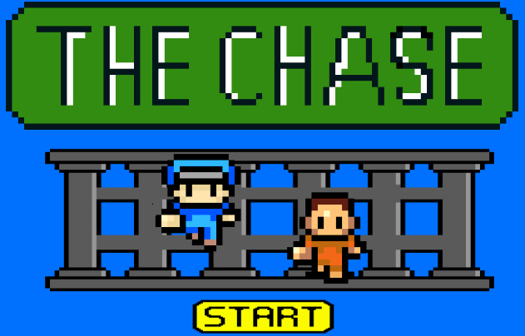
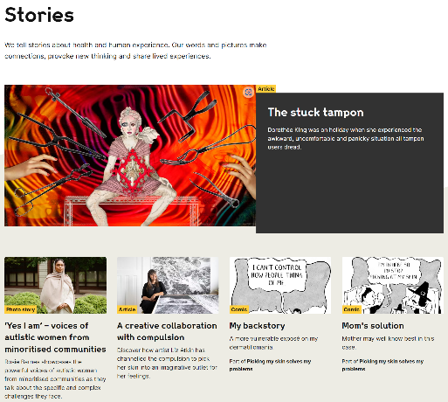
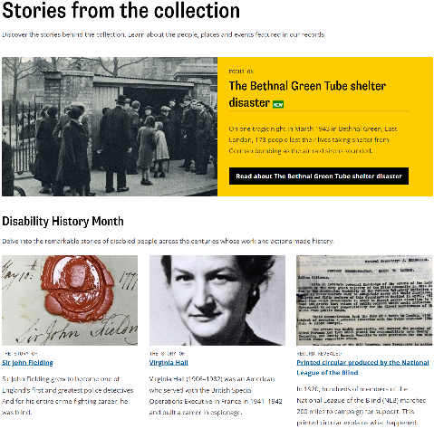
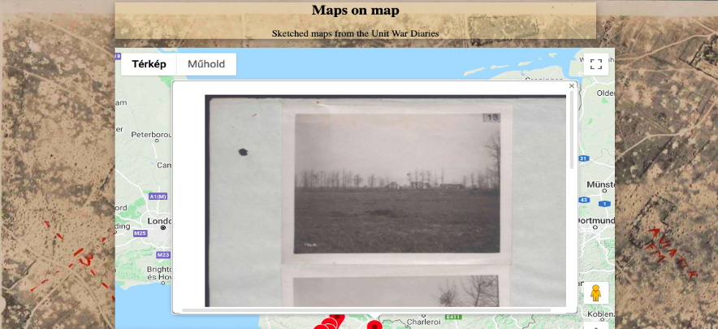
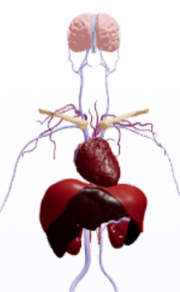
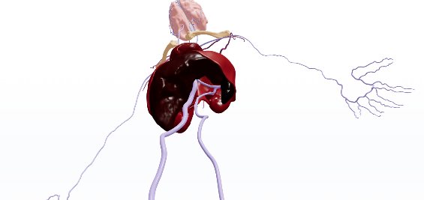
Internet Browsers
https://hello1024.github.io/TheChase/
https://www.atlomy.com/model/Hippocratic_Sacred_Disease_-_Vascular_System/72
by Andrea Kocsis
Notes:
This is another unintentional pun
I’m thinking of people (in general) on the internet, browsing the collection
This is perhaps not a useful audience to think about it, because it is so broad
Really, it just includes everyone who is not tech poor
So probably a better way to think about this is more in terms of its being one way of reaching the kinds of audiences that we were talking about last week
The digital aspect of those audiences
So this slide really ought to be pulled apart, but this is where I got to...
Of course there are already ways of reaching those audiences, such as telling relevant stories
These are the – very similar looking! – stories pages of our respective websites
Of course there are other ways to engage
ATLOMY seems to be pitched to a more academic audience
It is about ancient anatomy
It is quite classicist-y in that a lot of it is about exploring language
But it also presents 3D models of anatomy as described in particular texts, which is kind of fascinating
Interactivity can be effective, e.g. in games
The image up there is the winner of a game jam that TNA ran (before my time) to explore possibilities for gamifying transcription
It doesn’t work any more but apparently was like Frogger, but you’re running away from the police and transcribing text buys you more time
Or just “interactive things”
Maps on map is a prototype created by Andrea Kocsis, who was a research fellow with us
Uses a mapping interface – click on a place, see images about it from the unit war diaries
One thing that is noticeable about all of these examples is that they are not “text mining ish”
They might point to ways to engage digital audiences, but not especially through text mining
That doesn’t mean that such interfaces do not exist, I haven’t made a concentrated effort to find them
Although it might be telling that nothing sprang to mind when I started making this slide
It does make me wonder if these more statistical things are harder to make sense of
Perhaps you need a comfort level with data and these kinds of tools
Having done a very quick search, it does seem like the “default internet assumption” is that these are tools to be used by experts to interpret data
It seems quite obvious now that I’ve had that thought – disciplinary blinkers perhaps
Might be able to offer text mining (or other digital) tools that are tuned to particular audiences, for particular uses
This might help with the question of how to teach people to use unfamiliar tools like topic models
For example, by using selected topic models to tell a particular story
For example, about the representation of a particular community in sources held by Wellcome
With the ability to use those models as a starting point for exploring other, similar, models and finding more relevant snippets of text
A more general possibility might be what I’m thinking of as a way of being transparent about how things work
For example, building up a map of books that have no catalogue subject
Grouping together those that look similar from a topic model point of view
And perhaps showing the topic models
Letting people explore these “less knowable” parts of the collection
Showing provenance information in accessible ways might be another possibility...
I’m sure there is lots and lots that could be done here
I think this is a place where ideas need to be developed in dialog – BOTH
What audiences would we like to reach AND
What possibilities can digital methods create

Slide 12
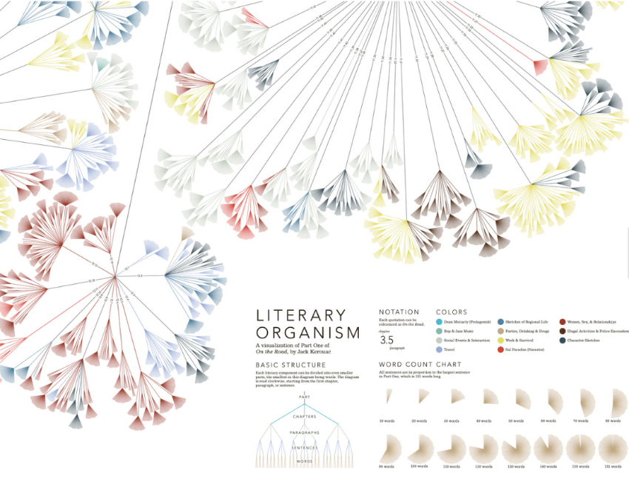
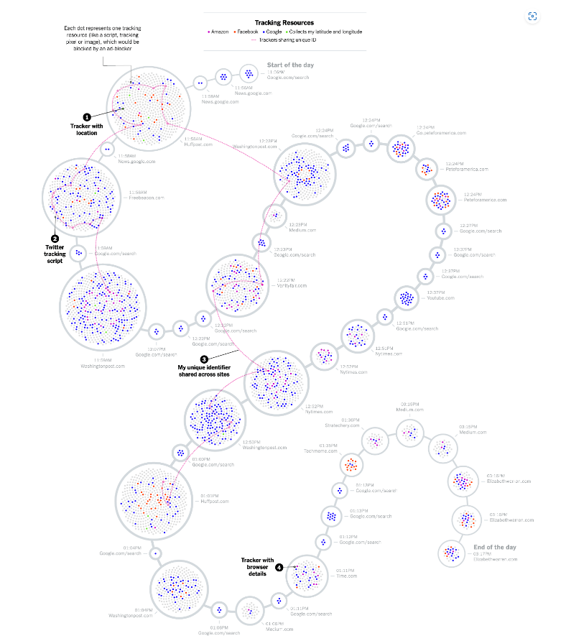
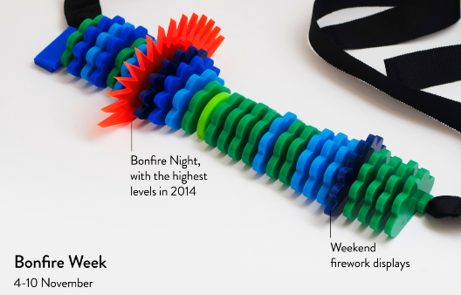
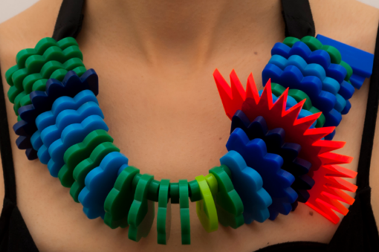
Artists & Other Creatives
https://www.stefanieposavec.com/writing-without-words
https://www.visualcinnamon.com/portfolio/new-york-times-digital-trackers/
https://www.stefanieposavec.com/airtransformed
Notes:
I feel like a lot of the value of text mining the collection
At least in the way that I have done it
Lies in inspiration
It feels like it might have some potential to inspire creative work
I’m aware that there are people who work at a sort of intersection of art and data visualisation
And actually, creative works based upon data views of the collection again become another way to engage audiences
Three examples here
The one on the left is a visualisation of web trackers by Nadieh Bremer, and is kind of scary
IIUC, this is all the trackers that a reporter encountered in one typical day on the web
The other two are by Stefanie Posavec, who you may know of as she has worked with Wellcome, including creating a visualisation for the Being Human gallery
The top right one is kind of appropriate for this project, as its a visualisation of Jack Kerouac’s On the Road
And then I just had to squeeze that necklace in
It’s a representation of air quality data from Sheffield – this one covers 4th to 10th November 2014
Bigger, spikier segments are worse pollution – “dangerous particulate levels have the potential to hurt/prick the finger of the wearer”
The big red one is Bonfire Night
This also emphasies that “data visualisations” don’t have to be things we look at on computers

Slide 13
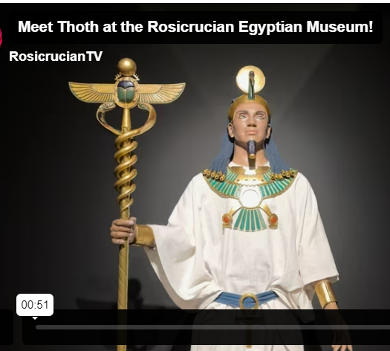
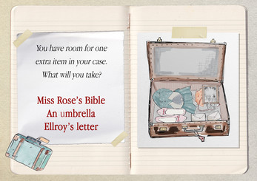
Exhibition Audiences
https://3foldgames.itch.io/windrush-tales
https://www.egyptianmuseum.org/thoth-ai-robot
Notes:
And I guess that links in nicely to this audience
Though of course physical representations of data aren’t the only way to use digital tools in exhibitions
Just a IIIF interface onto a book could add a lot over displaying it in a glass case
Interpretations of topic models produced from it could be another way
As could an interactive version of that “On the Road” visualisation
Interactive games are one way in to this
This is screenshot from a game about the experiences of the Windrush Generation
Which was in the Digital Storytelling exhibition at the British Library last year
At the other extreme – and this might well be going too far, but it does at least make use of digitised text in some sense --
In San Jose there is a Rosicrucian Egyptian Museum
They have built a robotic Thoth chat bot
If I understand correctly, it is trained on ancient esoteric texts
You can ask it questions, it will answer in that vein

Slide 14
Activity 1 What did we learn about text mining?
Notes:
This activity is sort of rolling together two things that I intended to do when I wrote the meeting invitation
This is not a test, there are no right or wrong answers, I wasn’t setting out to teach anything specific
But I am interested to know what thoughts you have, what your takeaways are, about text mining – or at least about topic modelling – and its application to your collection
Suggested headings:
Possibilities: what could we do with it
e.g. can we apply it in search, are distant views of the collection interesting, could we do storytelling with it
Limitations: what can’t we (or shouldn’t we) do with it
Misc: any other thoughts

Slide 15
(Post) Activity 2 Collaborative Experimentation Evaluation
Notes:
Post-activity because I’m actually asking you to do this _after_ this session

Slide 16
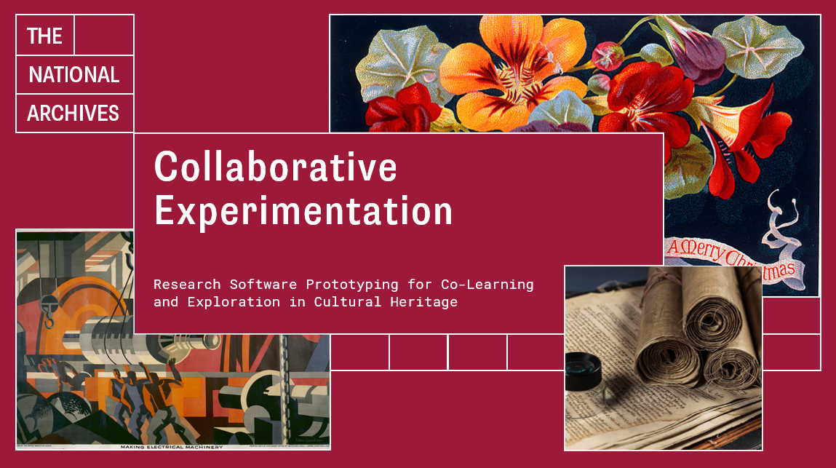
Evaluation
Notes:
I know I don’t like filling out feedback forms, but I’ve realised it would be really helpful to have some feedback like that
I’ll come back to that, but to explain what I’m asking for
I’ve focused on the prototypes in these meetings
Because the intention of the project was that prototyping would be a vehicle for, or provocation to, cross-disciplinary communication and collaboration
As it says on the title slide from my first visit there
While I have thoughts about how it went, they’re very much just from my perspective
And I particularly don’t have insight into how this compares with other activities at Wellcome
And while I’ve seen a bit of your working culture during these visits, you’re all immersed in it
And it was very apparent to me while writing that paper that I don’t really have any way to know how that aspect of the project is going from your point of view
Both positive and negative feedback is really helpful in evaluating how this went
And thinking about how to do similar activities in the future
So I’ve made a Padlet where you can drop any thoughts – I’ll post this link in the Slack channel too
It contains a couple of prompts, but they’re just to try to stimulate thought
Thoughts around the helpfulness or unhelpfulness of prototypes are likely to be helpful.
But honestly, any thoughts about any aspect of the project are probably going to be useful.
It’s also anonymous, as far as I can tell, at least if you don’t sign in
Of course I’m also happy to hear direct from you either after this session or in emails, Slack posts, etc etc if you prefer
I’m not going to ask you to do it right now, because I think its easier to give feedback if I’m not watching you do it
But I’d be grateful if you could aim to do it today, perhaps during the remaining time that was allotted for this session
So this is actually the end
And that means that we’re at the end of my visits
It’s kind of whizzed by for me
I think this project has been more demanding of host institution time than many professional fellowships are
I’ve learned a huge amount, I think I’ll be digesting for a while, so I can say for me it has been really really useful
So thank you all very much for being generous with your time

Slide 17
Thank you
Bernard Ogden
The National Archives
Kew, Richmond
TW9 4DU

